Slide 1
The Next Generation of Teaching and Learning Tools
Charles Severance
Sakai PMC Chair
LongSight, Inc.
University of Michigan

Slide 2
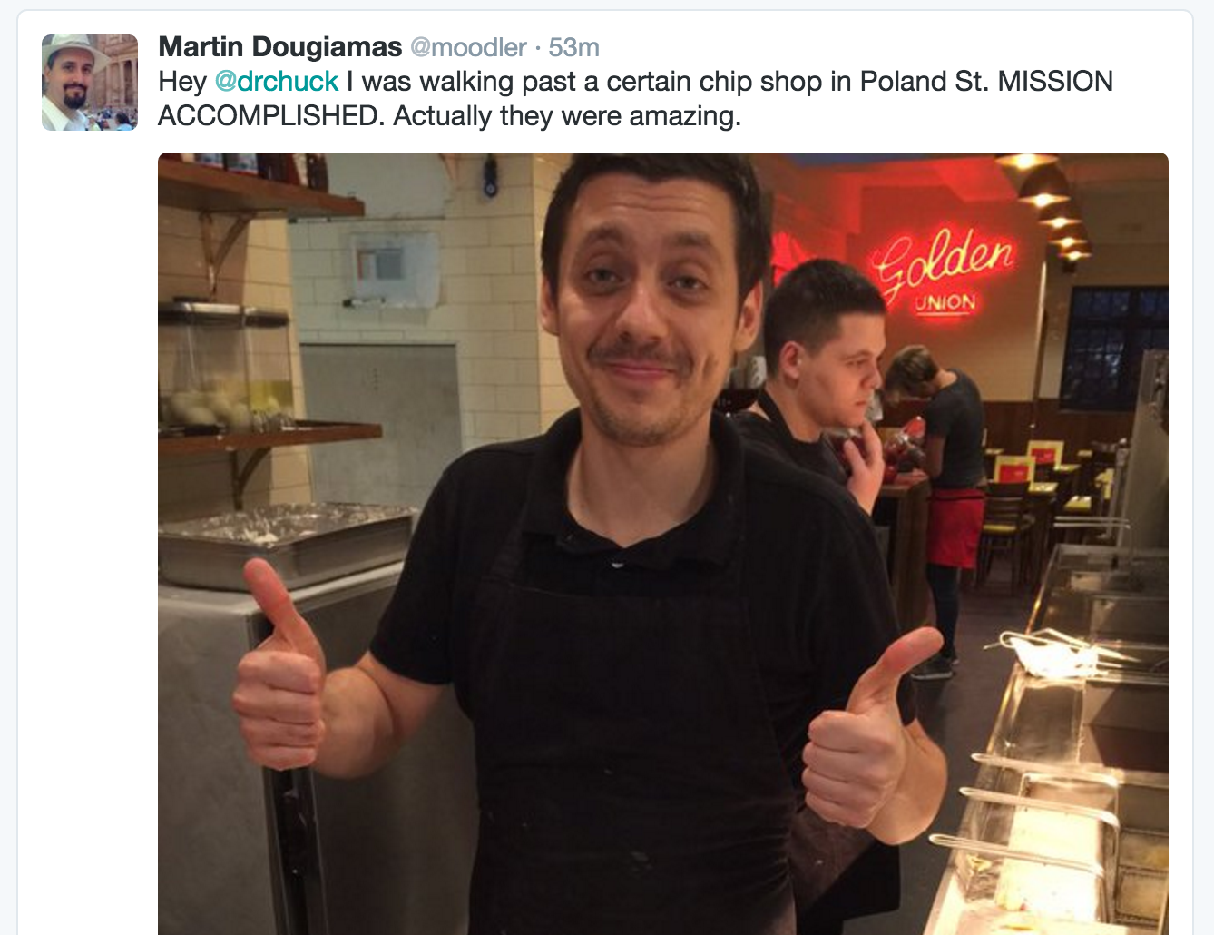

Slide 3
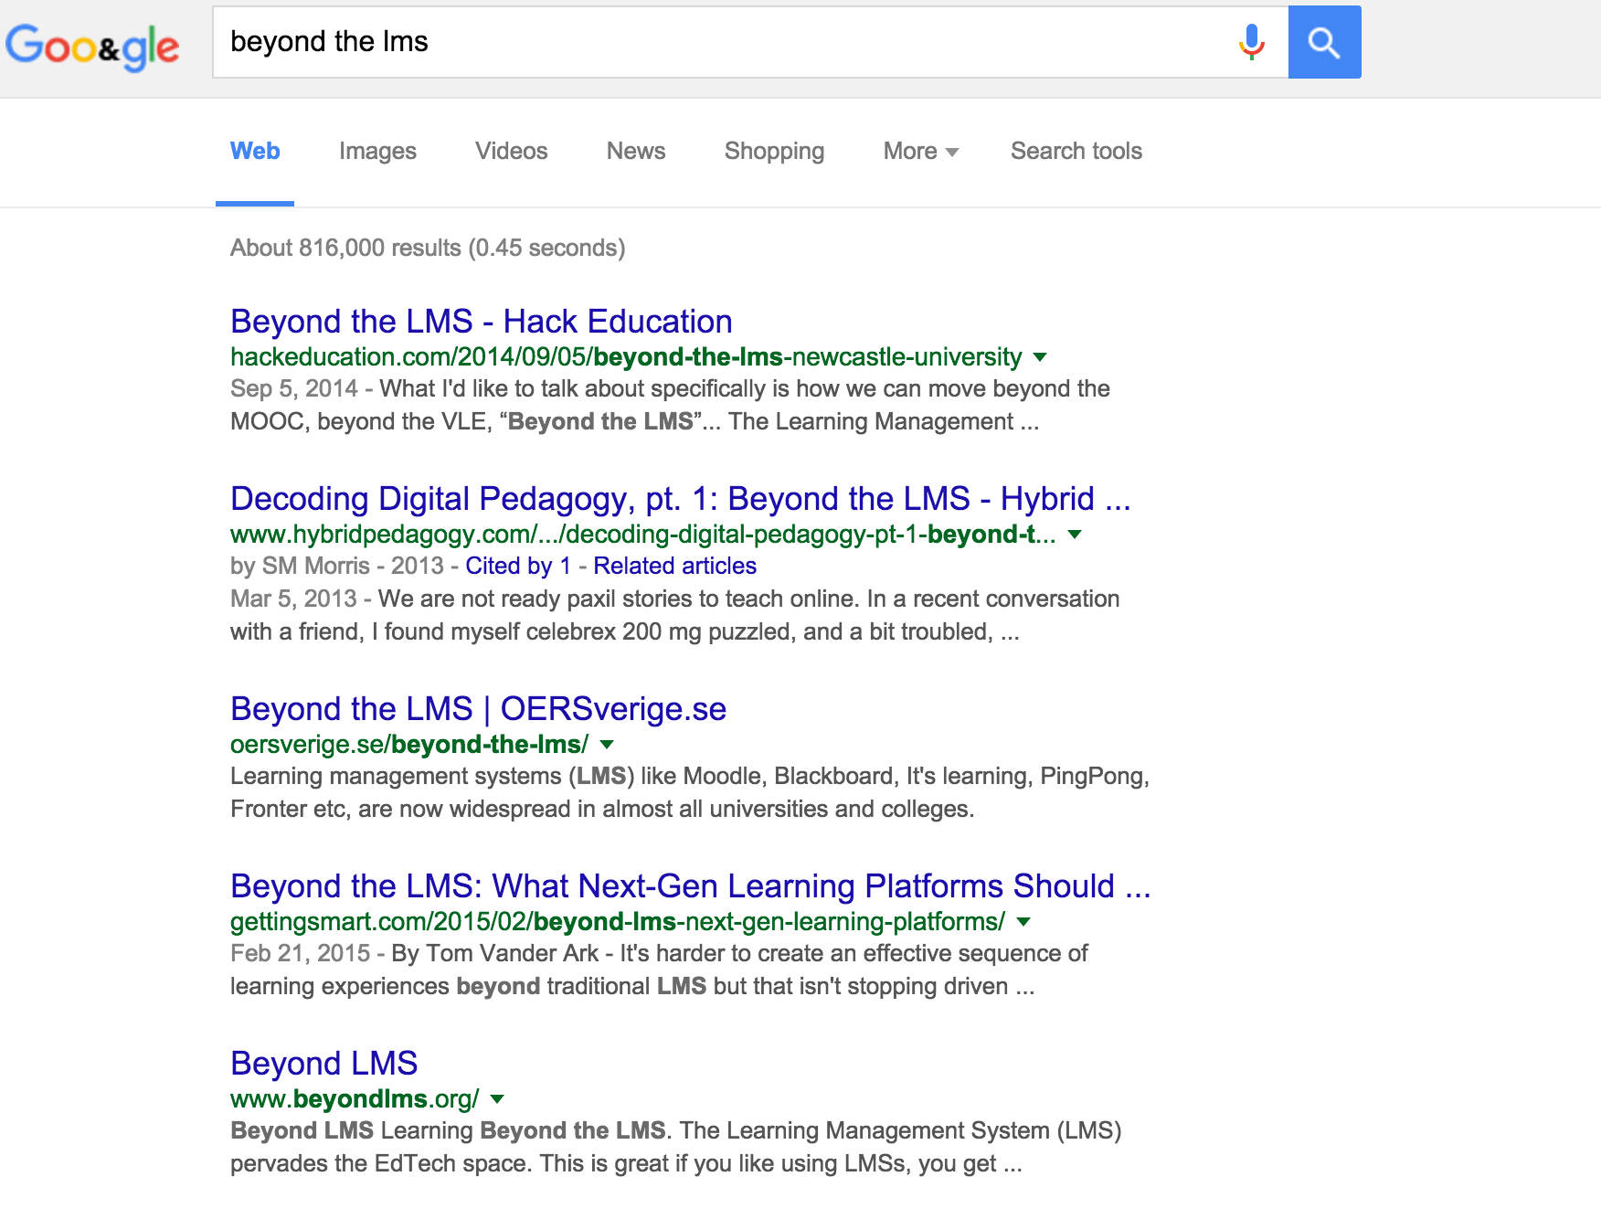
816 Results

Slide 4
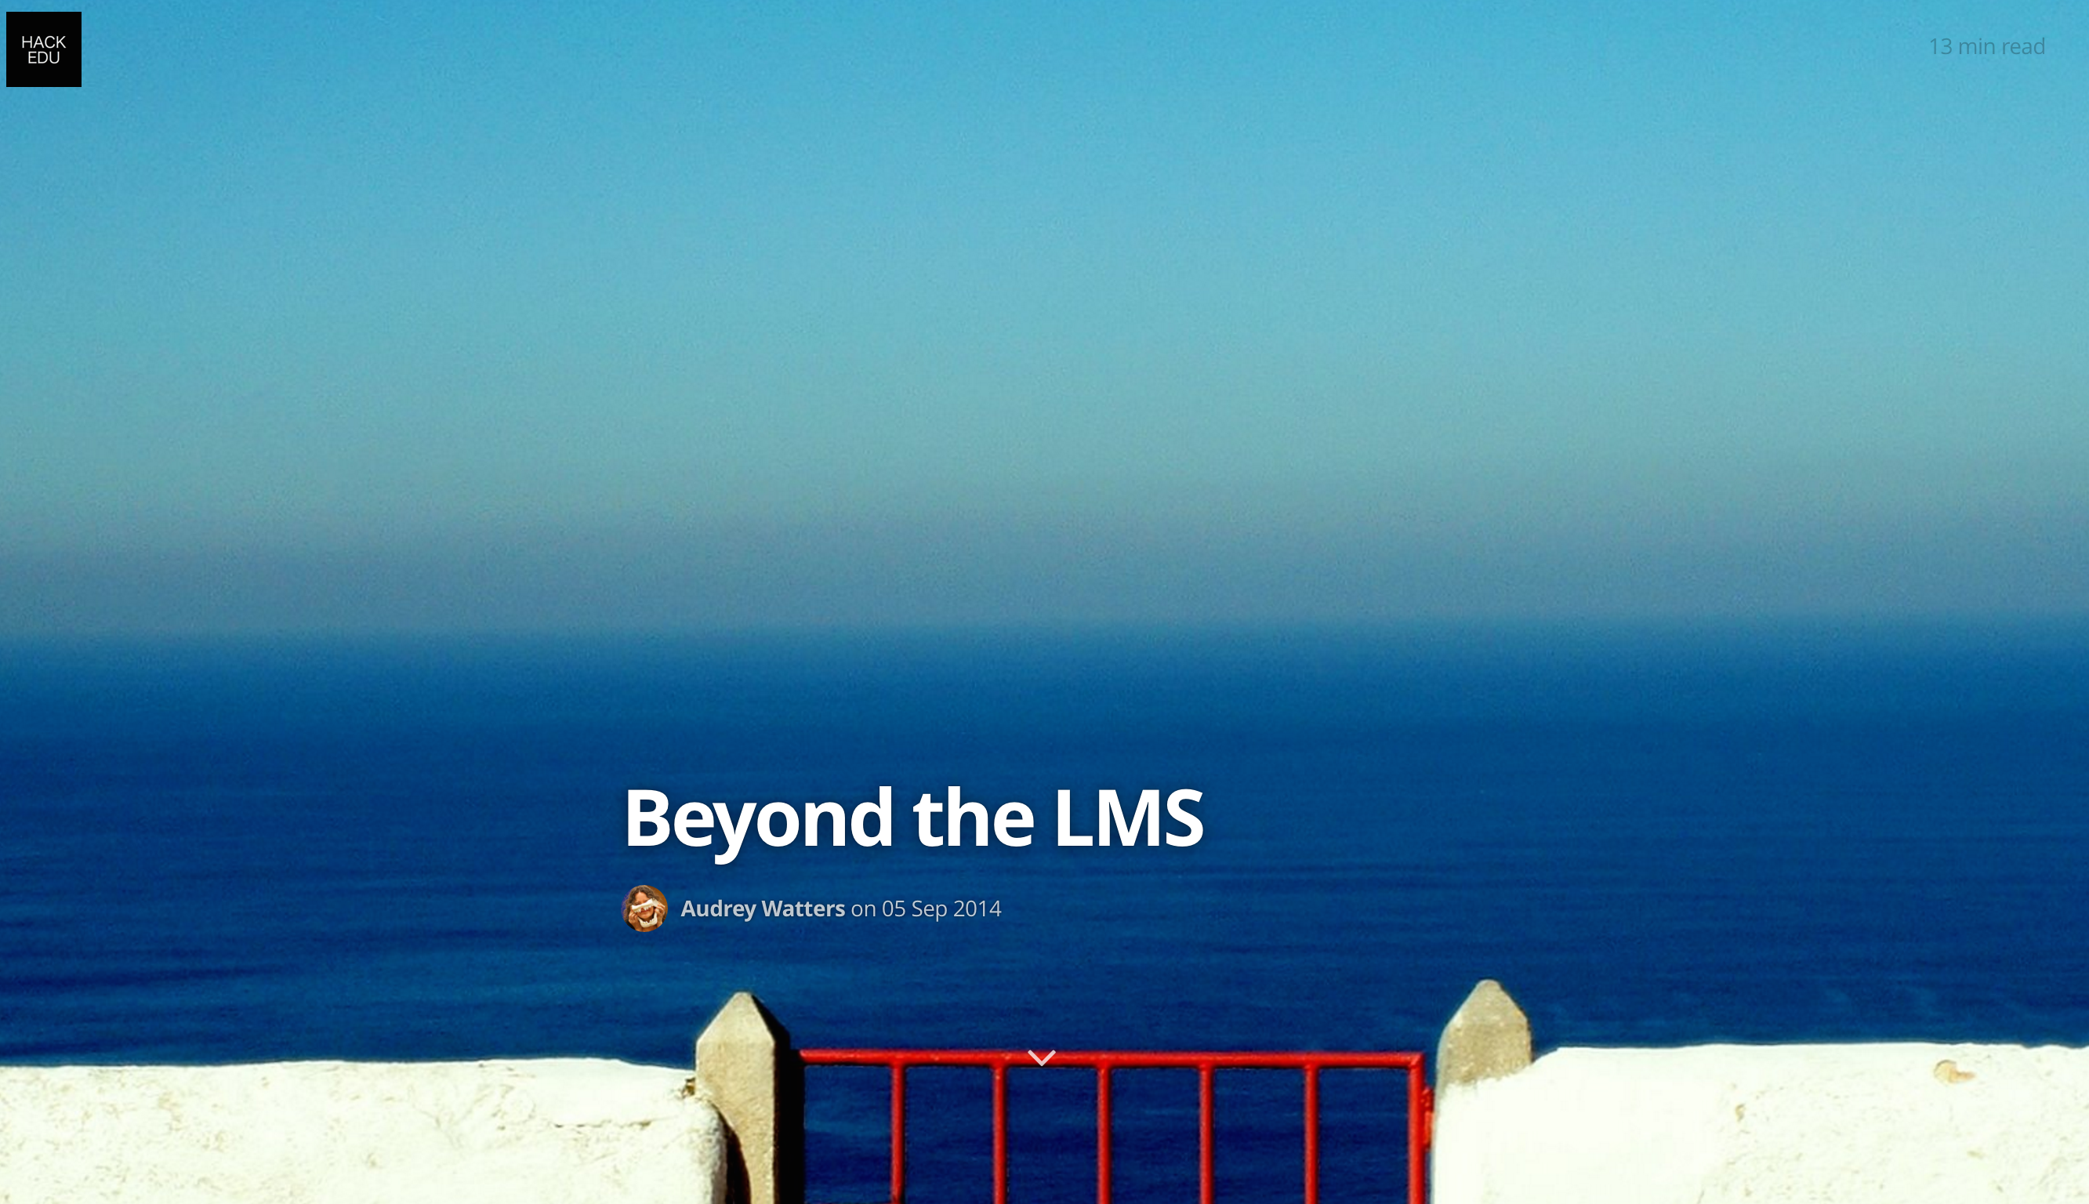
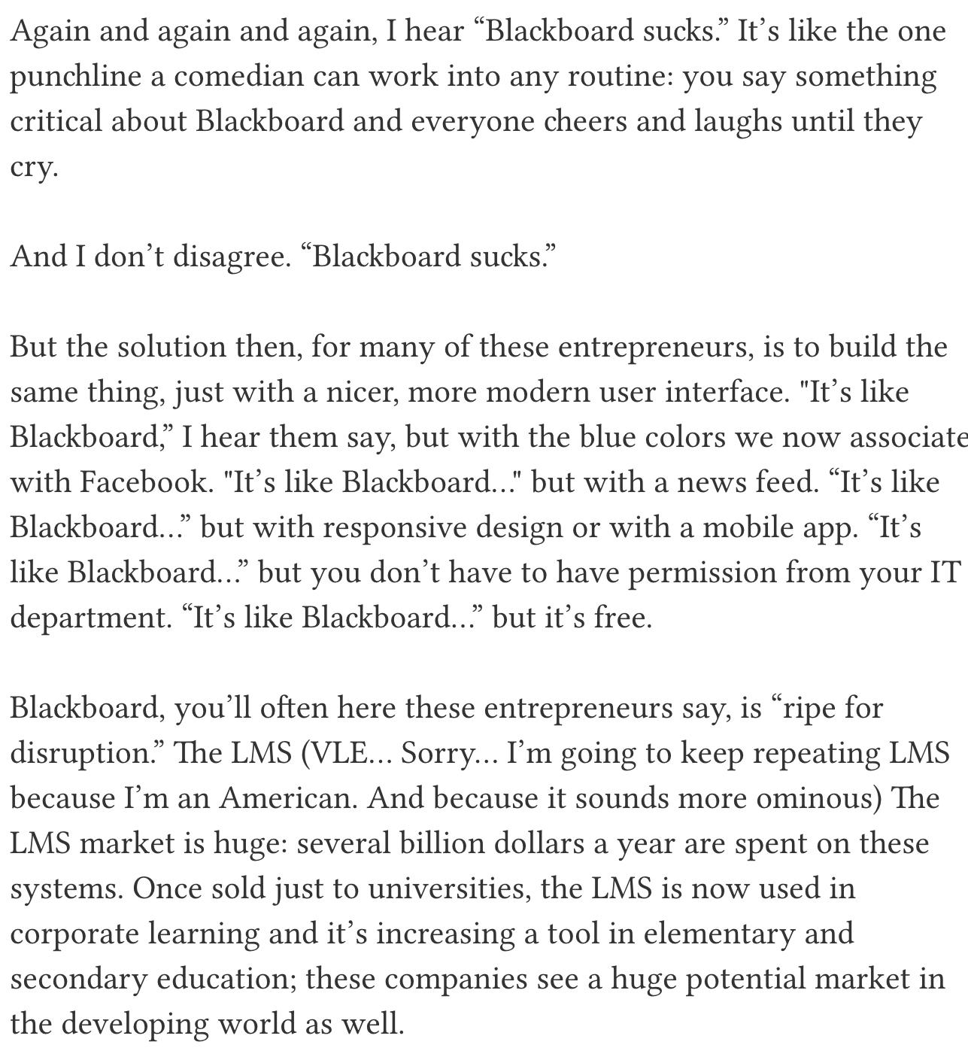
http://hackeducation.com/2014/09/05/beyond-the-lms-newcastle-university/
Notes:
Walls not having the learner at the center...

Slide 5
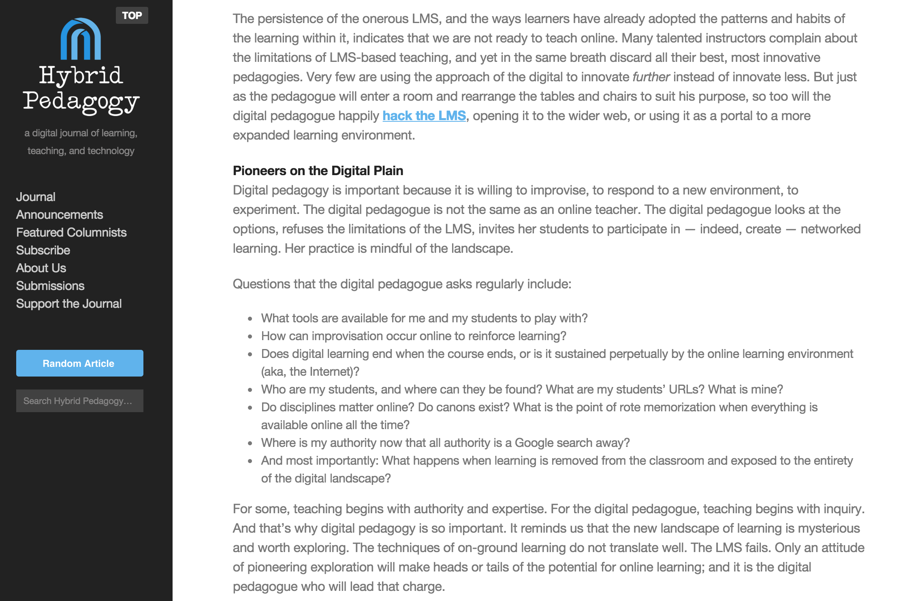
http://www.hybridpedagogy.com/journal/decoding-digital-pedagogy-pt-1-beyond-the-lms/

Slide 6
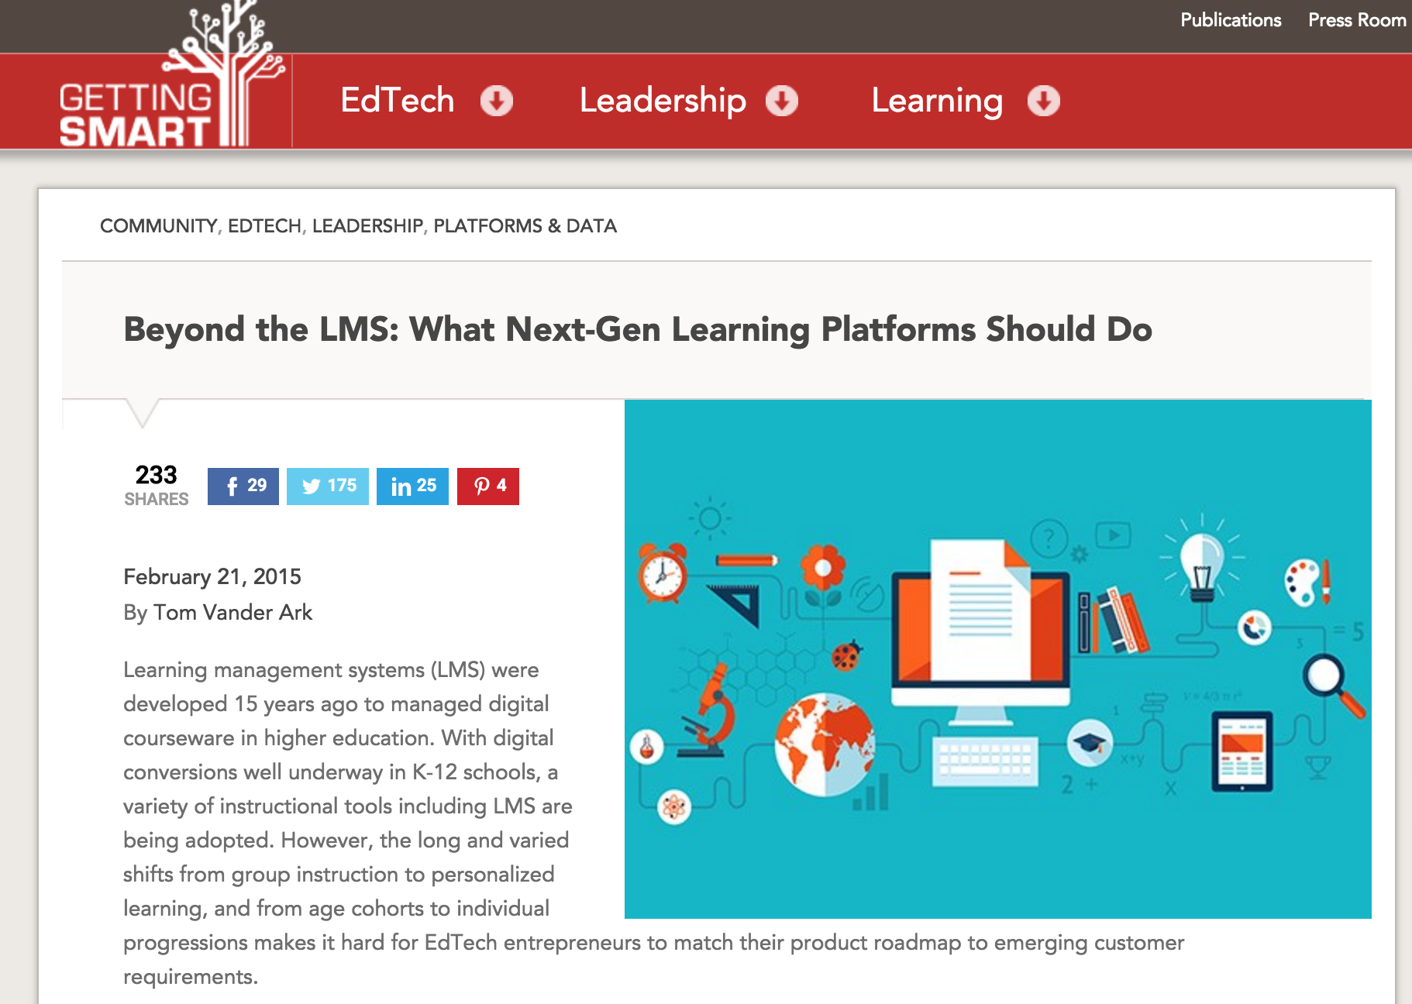
Weak demand articulation (i.e., slow shift to digital, varied requirements, tortured purchasing procedures that favor low bids rather than quality articulation);
Historic underinvestment in EdTech (compared to other $1T sectors); and
Well intentioned federal, state and philanthropic projects have chilled investment and delayed progress.
http://gettingsmart.com/2015/02/beyond-lms-next-gen-learning-platforms/

Slide 7
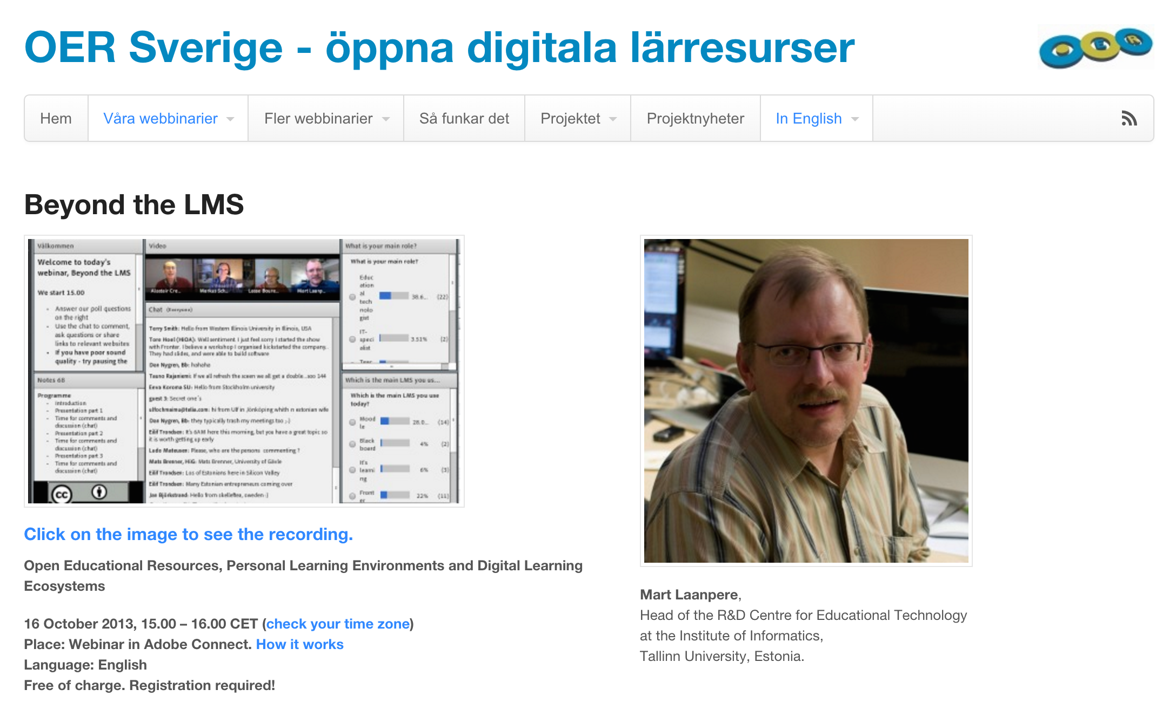

Slide 8
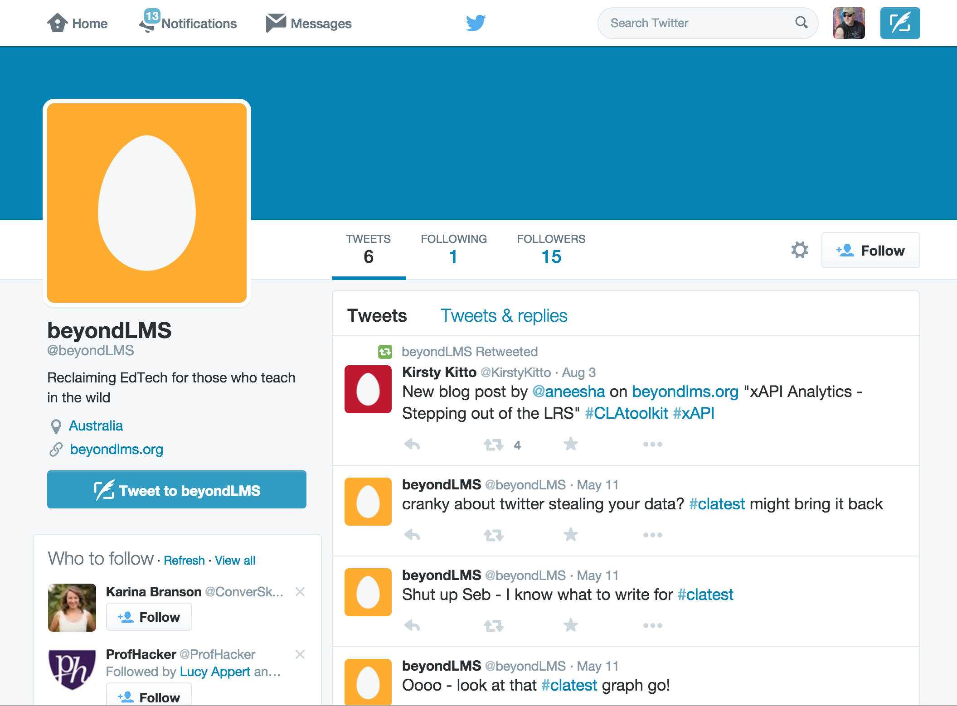
www.beyondlms.org

Slide 9
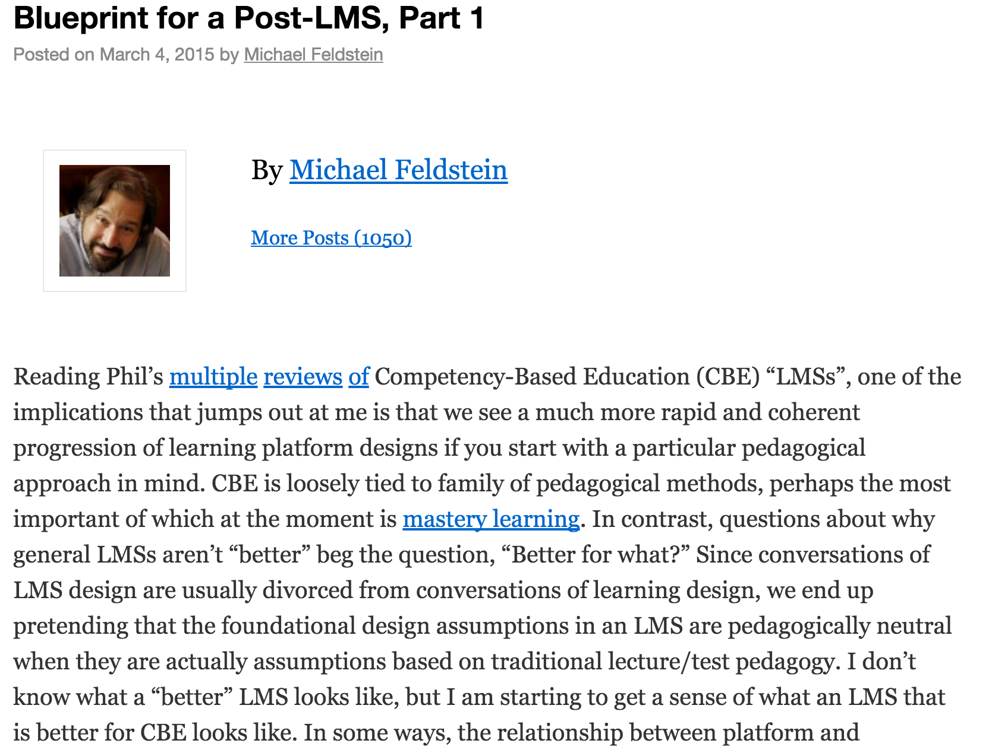

Slide 10
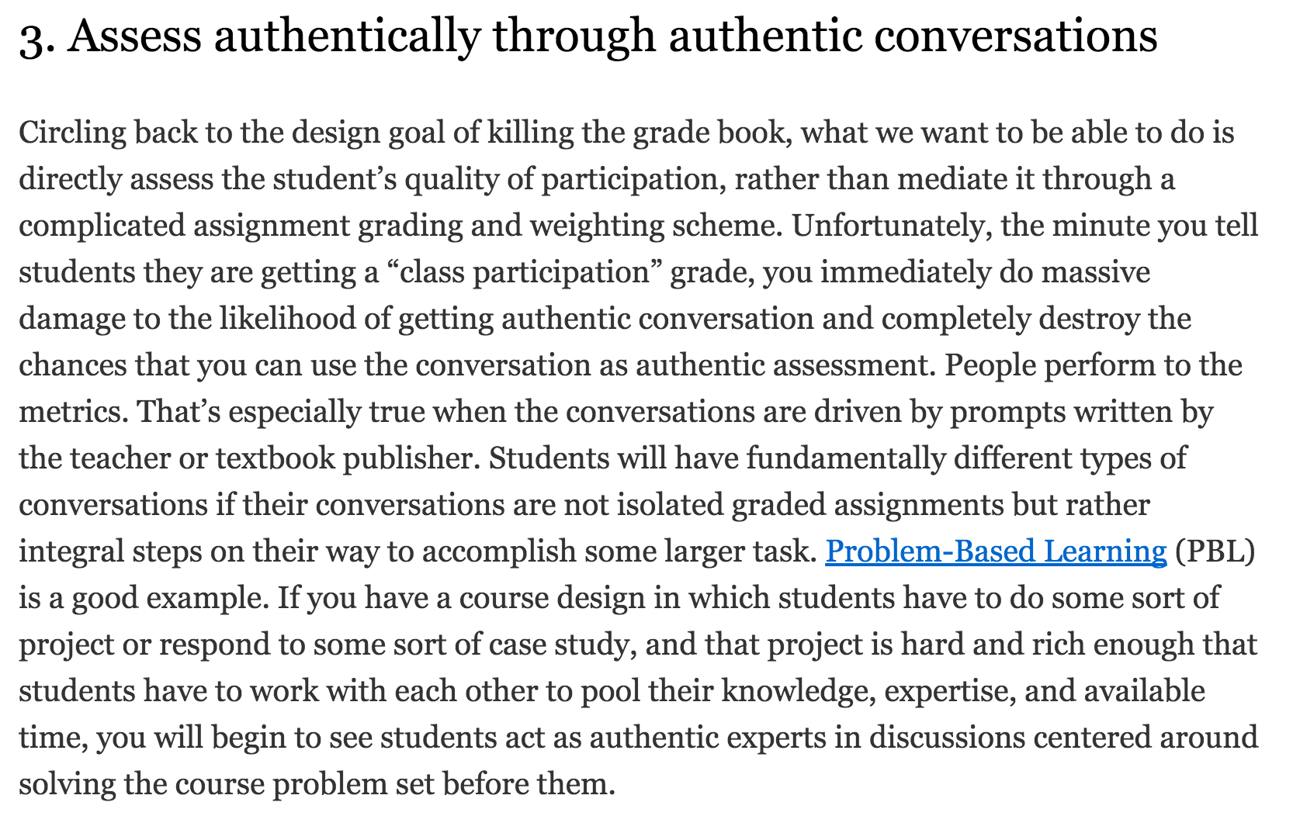

Slide 11
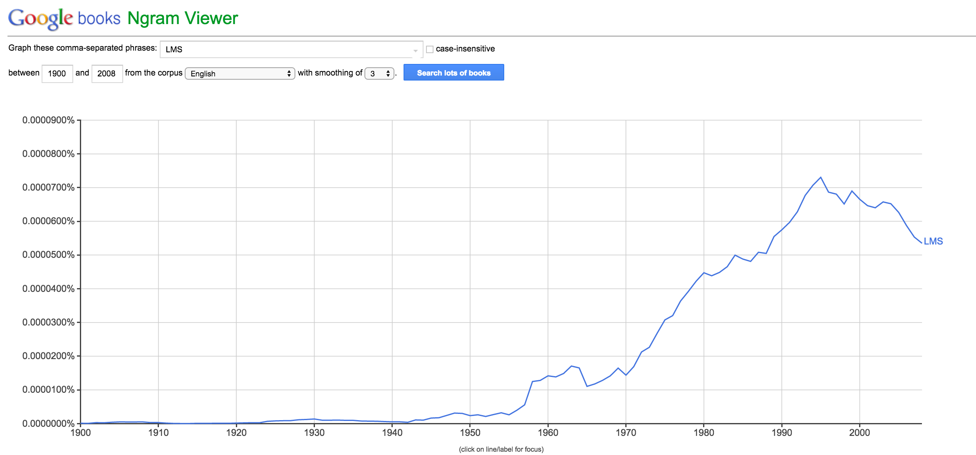

Slide 12
My recent trip to Hawaii
(to give a keynote talk about MOOCs and education)

Slide 13




Slide 14

Where is the bloody lava?
https://en.wikipedia.org/wiki/Volcano#/media/File:Lava_entering_sea_-_Hawaii.png

Slide 15



Slide 16

Standards
IMS Common Cartridge – 1.0, 1.1, 1.2, 1.3, 2.0
IMS Learning Tools Interoperability 1.0, 1.1, 2.0, 2.1, 2.2
IMS LTI Content Item - Public Draft
IMS LTI Roster Services – WG Draft
IMS LTI Outcomes Services – in WG Draft
IMS Caliper 1.0
IMS OneRoster – Rest-based SIS integration
IMS CASA – WG – Draft
IMS CC / EPUB 3.0 Coordination

Slide 17
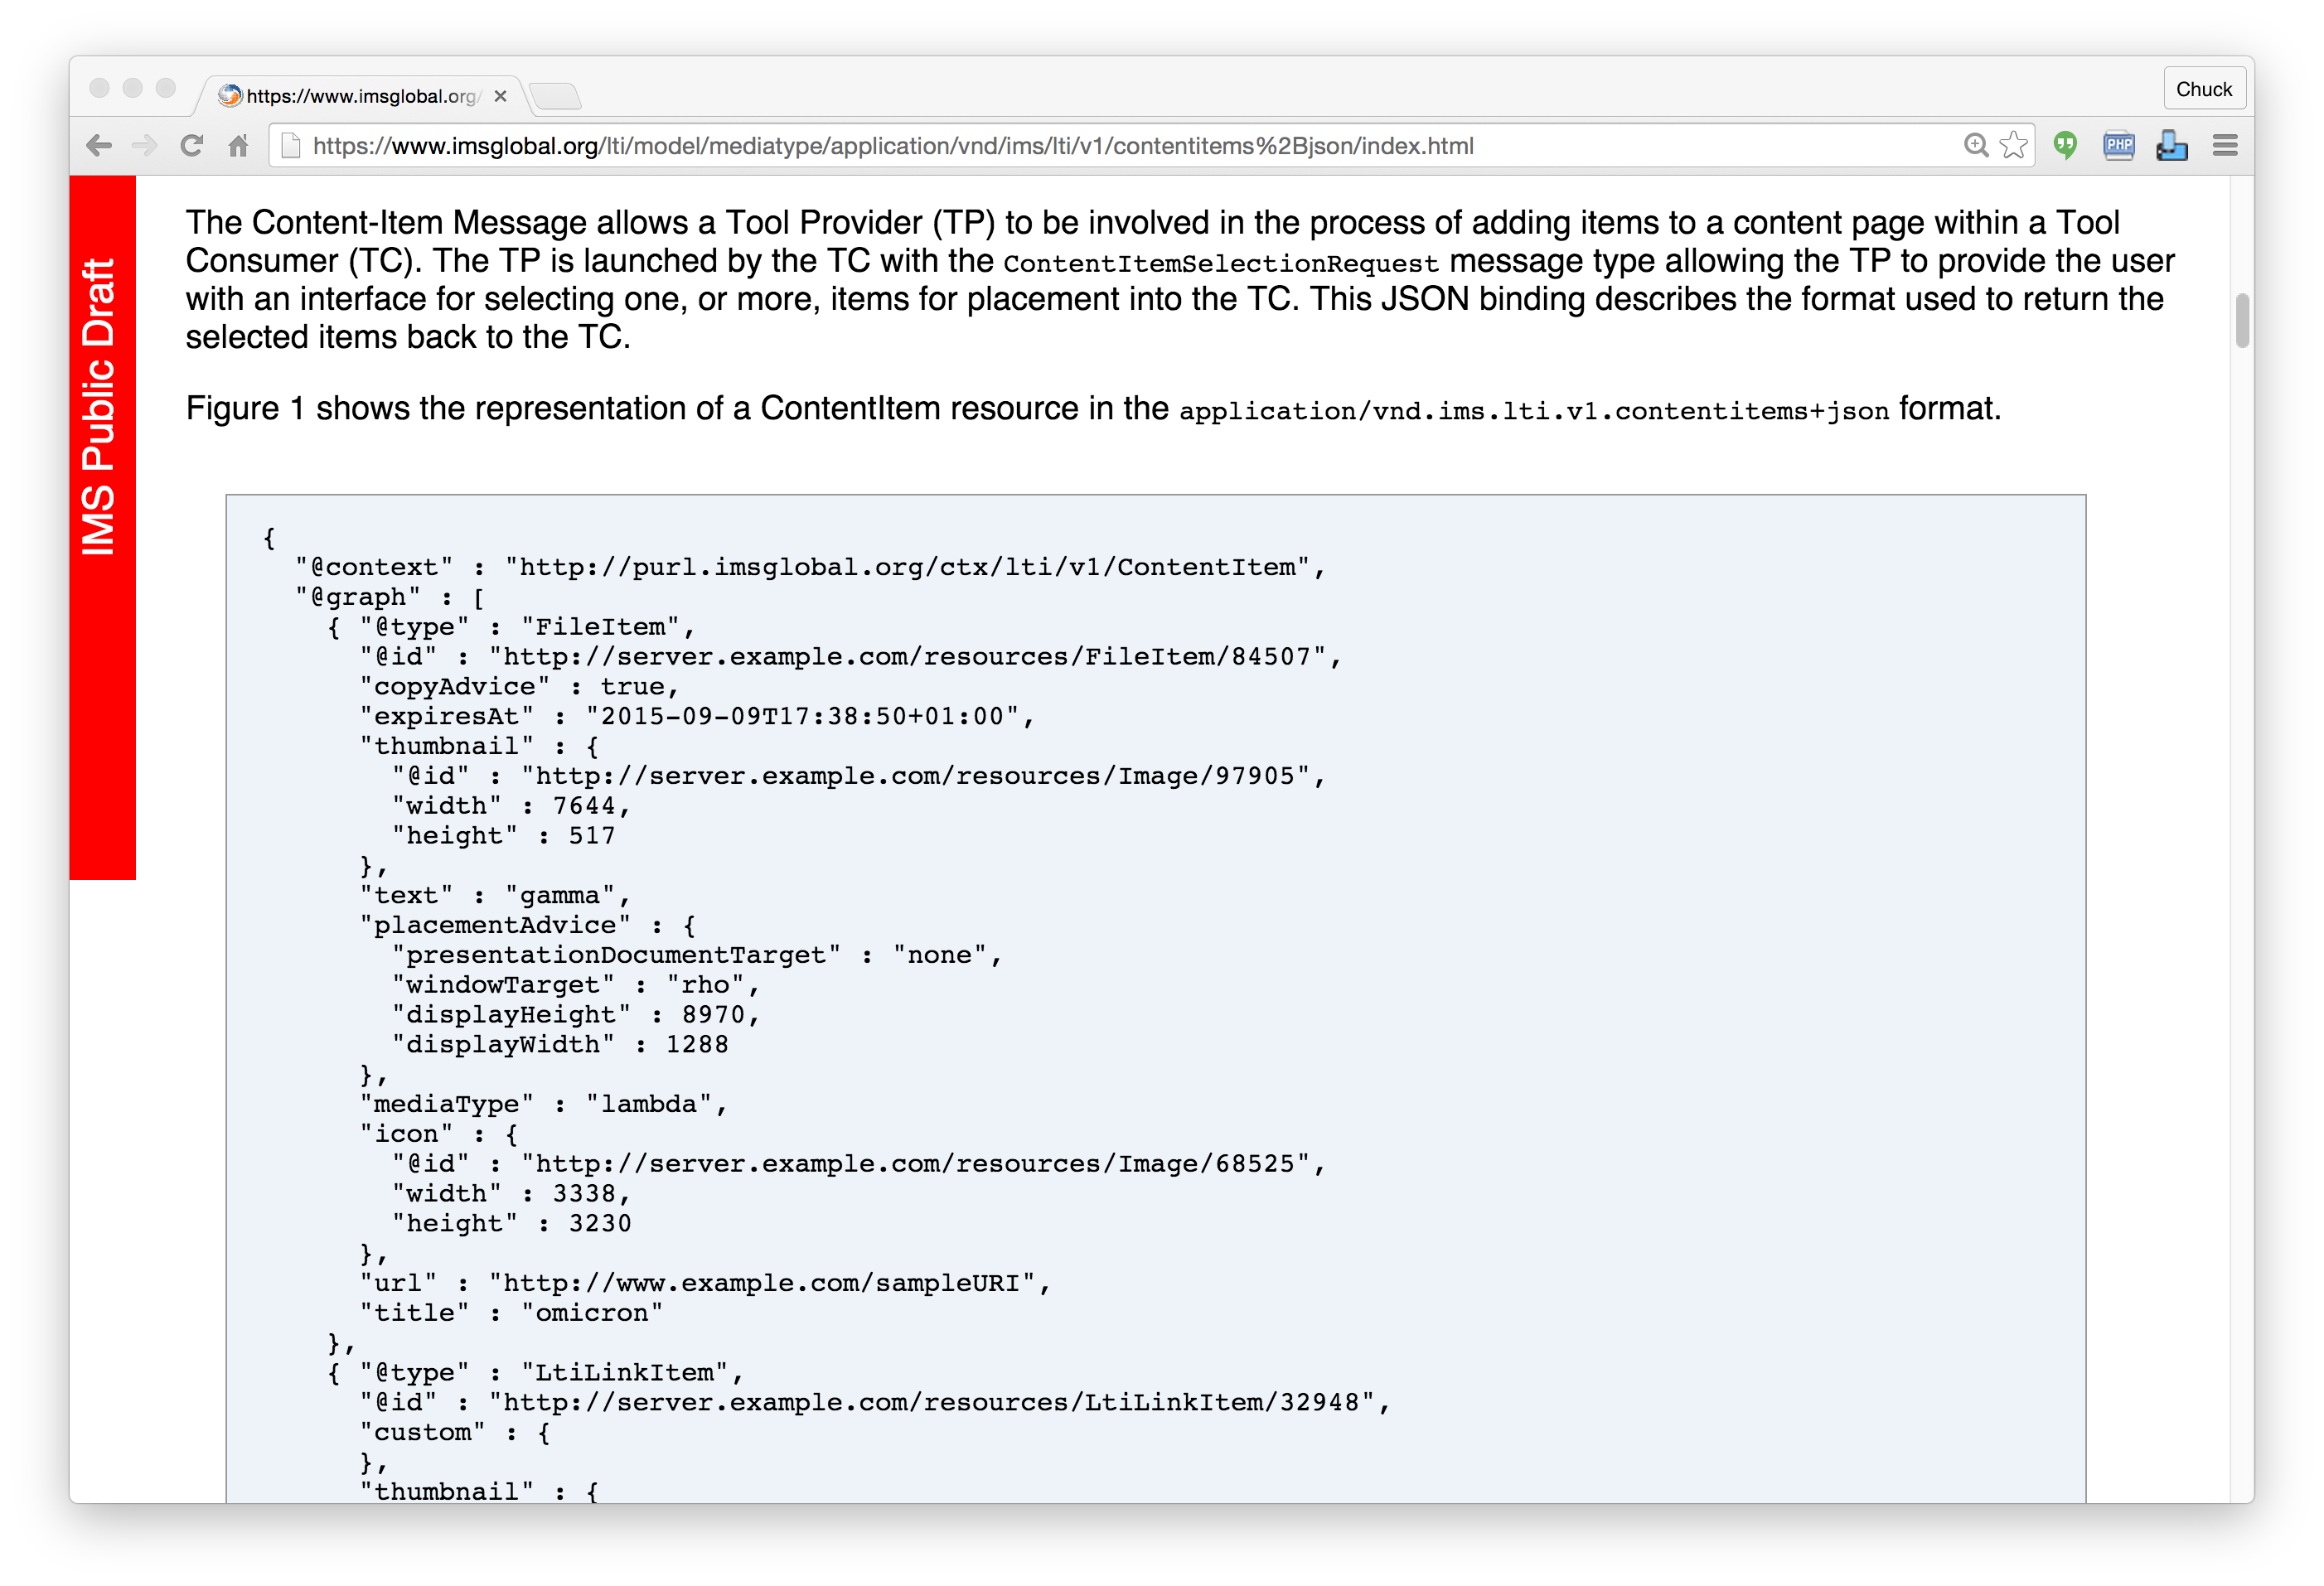
IMS
Content
Item
https://www.imsglobal.org/specs/lticiv1p0

Slide 18

IMS Content Item Launch
APP
LMS
Launch Picker
APP
APP
Launch Picker
Content
Repository

Slide 19
IMS Content Item Return
APP
LMS
APP
APP
APP
URL, Configuration
Content
Repository
IMS Common
Cartridge (ZIP File)

Slide 20
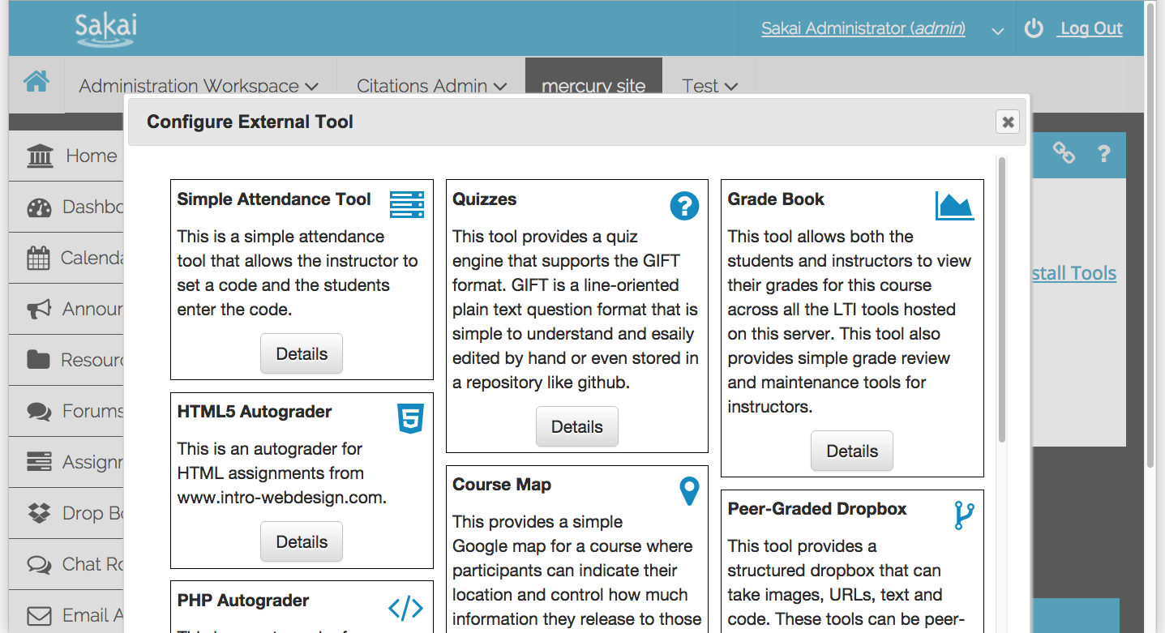
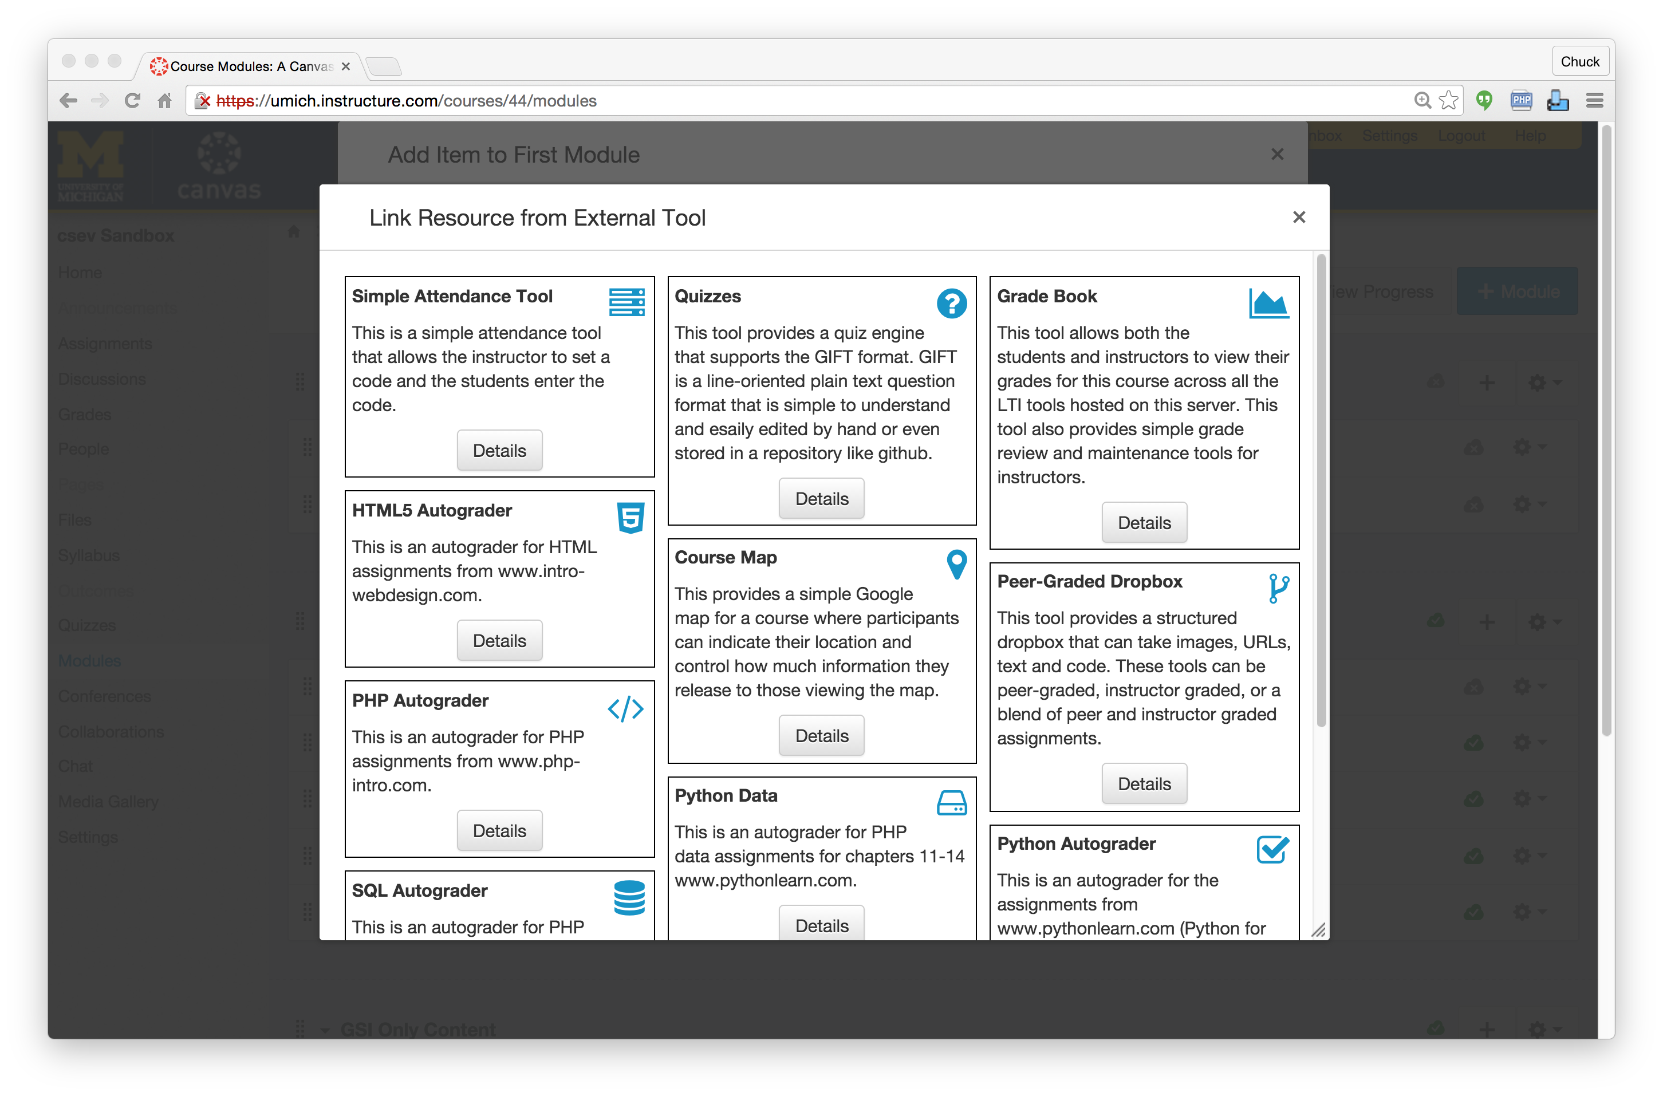

Slide 22
Standards Score Card
LMS | LTI 1.x | Common Cartridge | Content Item | LTI 2.x | Caliper
Canvas | A | A | A | B+
Sakai | A | A | A- | A-
Moodle | A | A | B | B
D2L | A | A
Blackboard | A | A

Slide 23
Who are the Competitors in the New Space?

Slide 24


D'Arcy Norman's Law of eLearning Tool Convergence
Any eLearning tool, no matter how openly designed, will eventually become indistinguishable from a Learning Management System once a threshold of supported use-cases has been reached.
http://darcynorman.net/2013/02/15/normans-law-of-elearning-tool-convergence/

Slide 25

D'Arcy Norman's Law of eLearning Tool Convergence
Any eLearning tool, no matter how openly designed, will eventually become indistinguishable from a Learning Management System once a threshold of supported use-cases has been reached.
http://darcynorman.net/2013/02/15/normans-law-of-elearning-tool-convergence/

Slide 26
Top Teaching Destinations ^{[1]}
online.dr-chuck.com - 7800
Udacity – Not reported (assume 50% of edX)
edX – 5 million
Coursera – 16 million
My two courses are approaching their 1 millionth enrollment
CodeAcademy – 24 Million (2014 number)
Edmodo - ??
[1] Single instance cloud-hosted learning platforms intent on making money
Notes:
Khan Academy – 10M per month

Slide 27
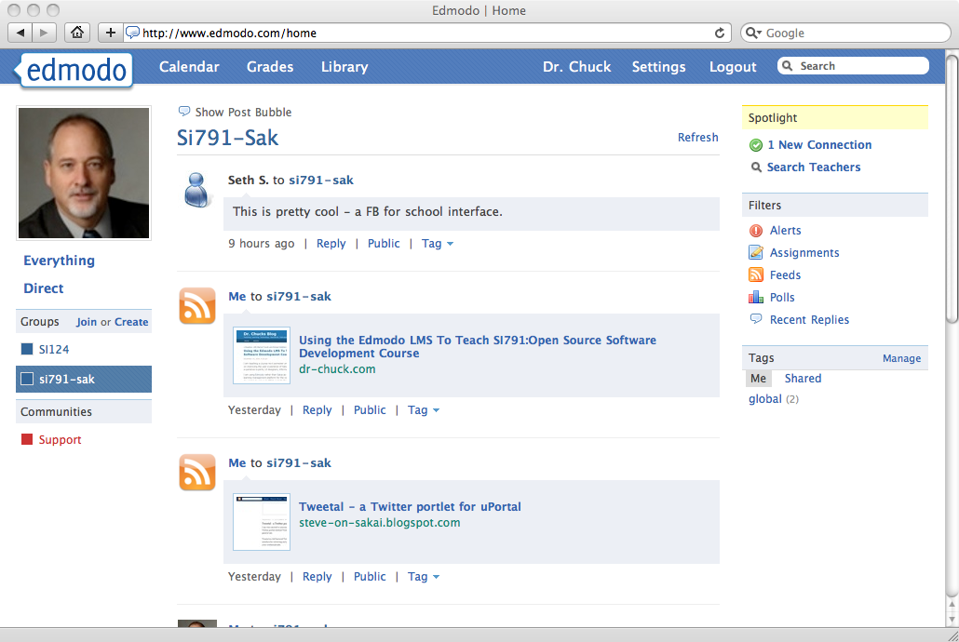
http://www.edmodo.com/public/si791-sak/group_id/161836
Contact Chuck for Edmodo group code
January 2011

Slide 28
http://gettingsmart.com/2015/02/beyond-lms-next-gen-learning-platforms/

Slide 29
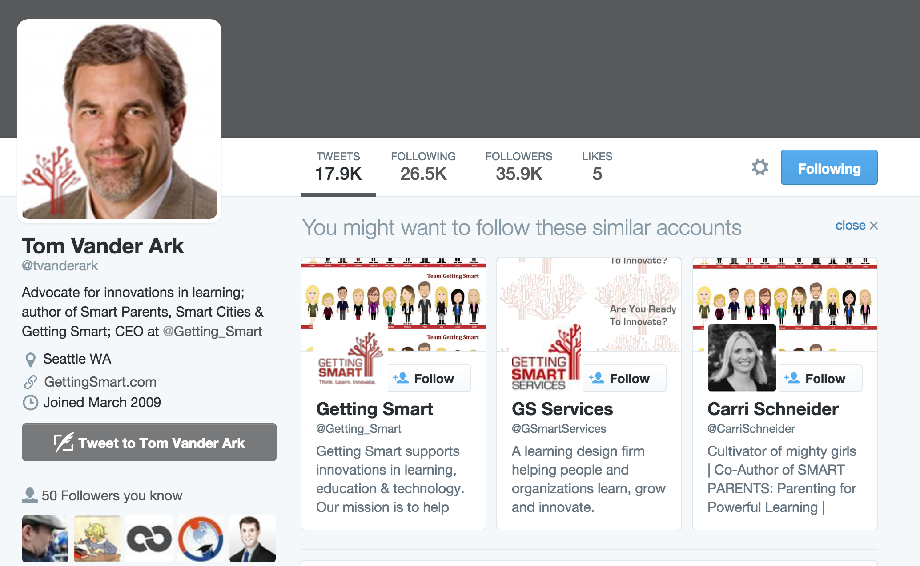
http://gettingsmart.com/2015/02/beyond-lms-next-gen-learning-platforms/

Slide 30
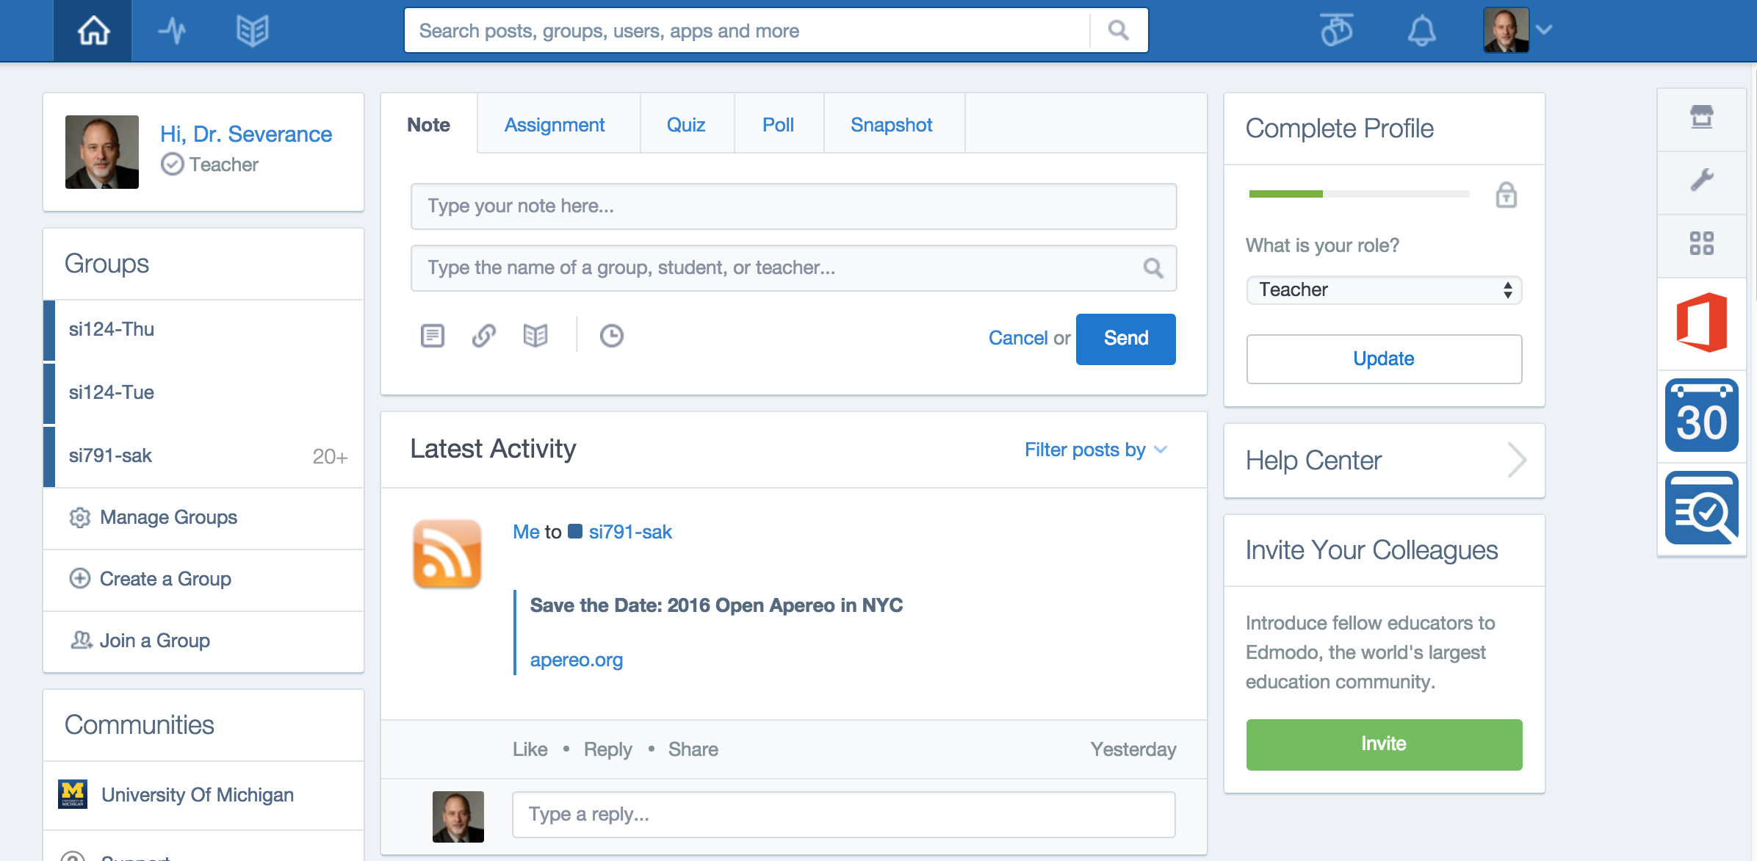

Slide 31
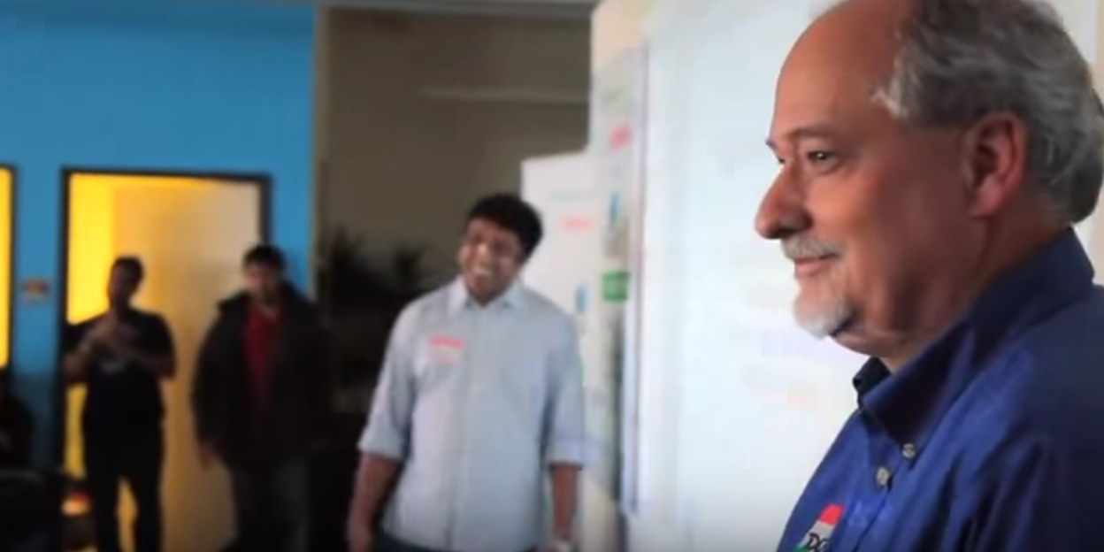
Startup Weekend EDU San Francisco
https://www.youtube.com/watch?v=jjgg63cGRLY
June 2011

Slide 33
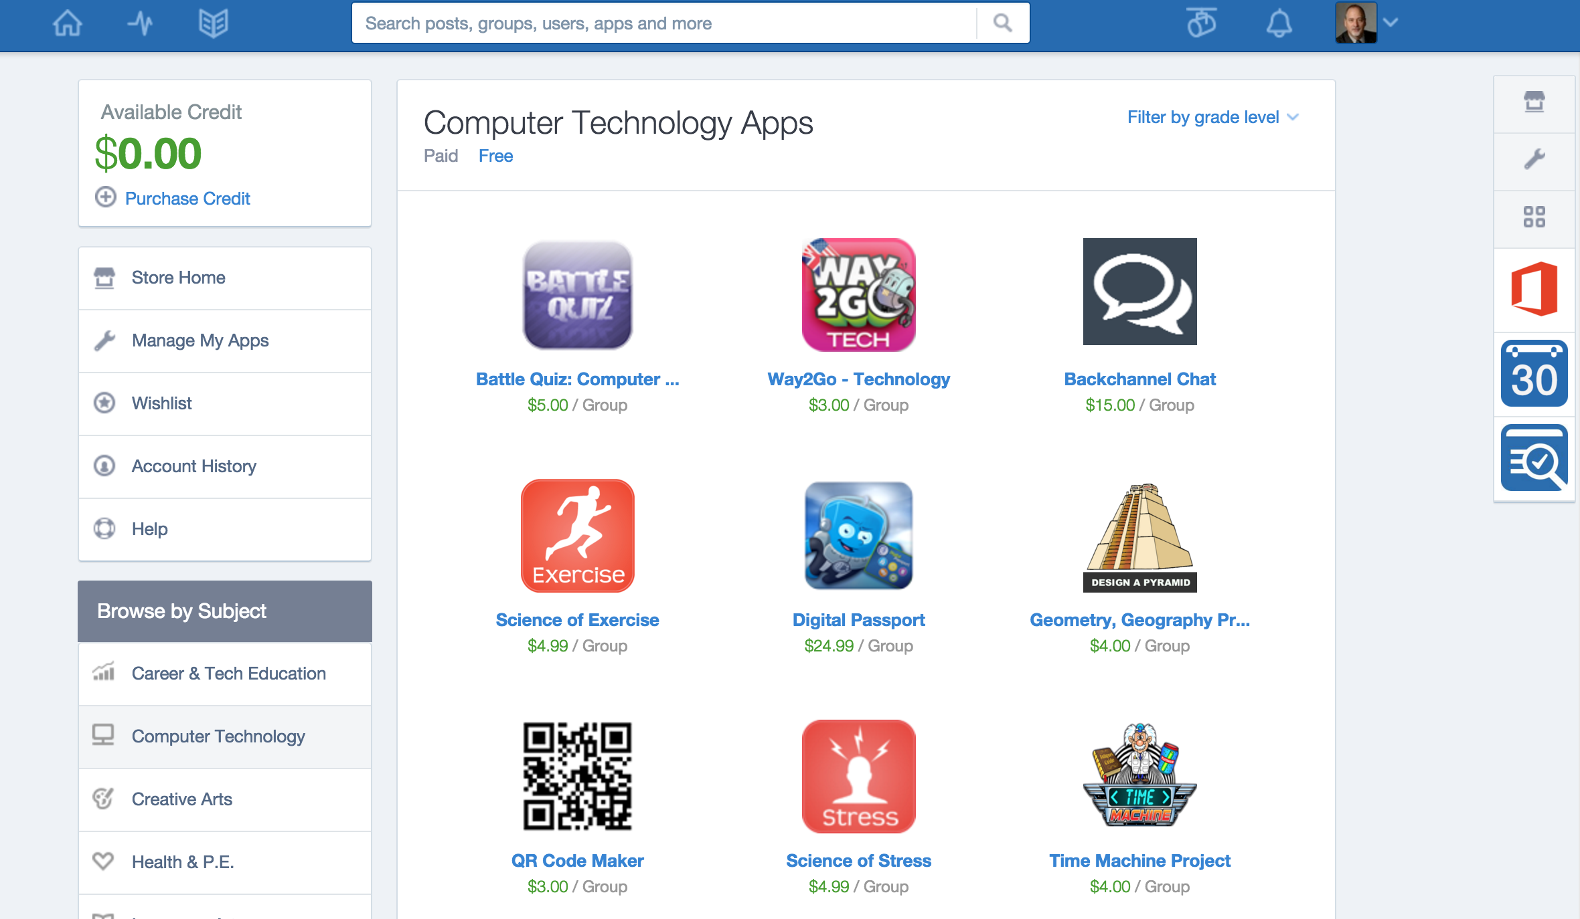

Slide 34
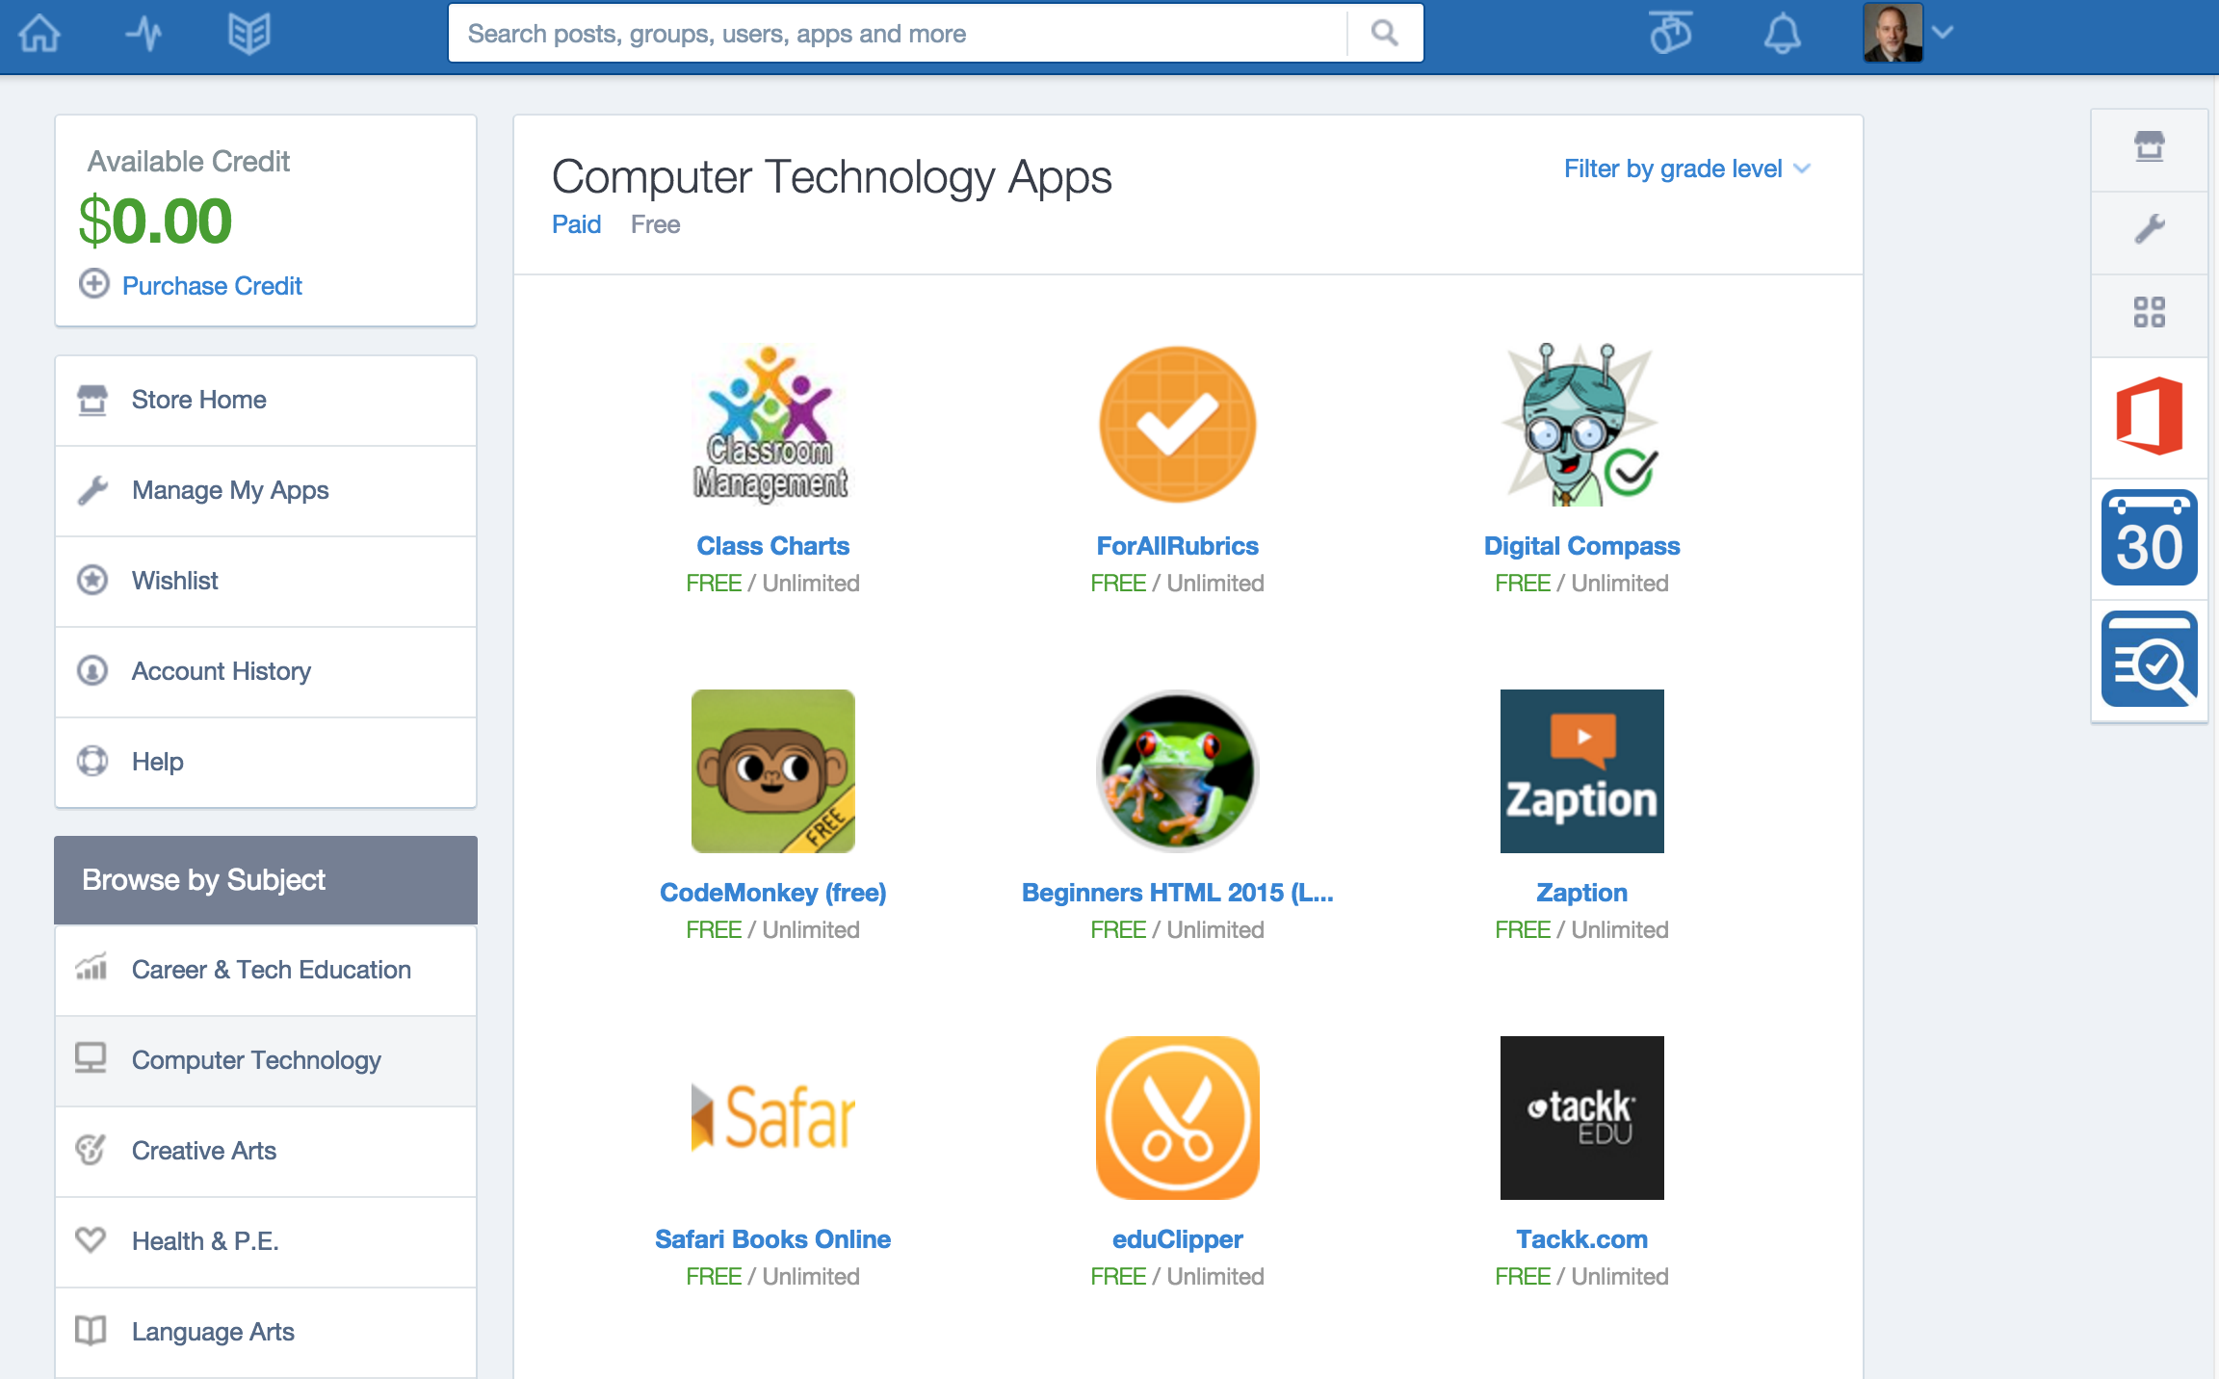

Slide 35
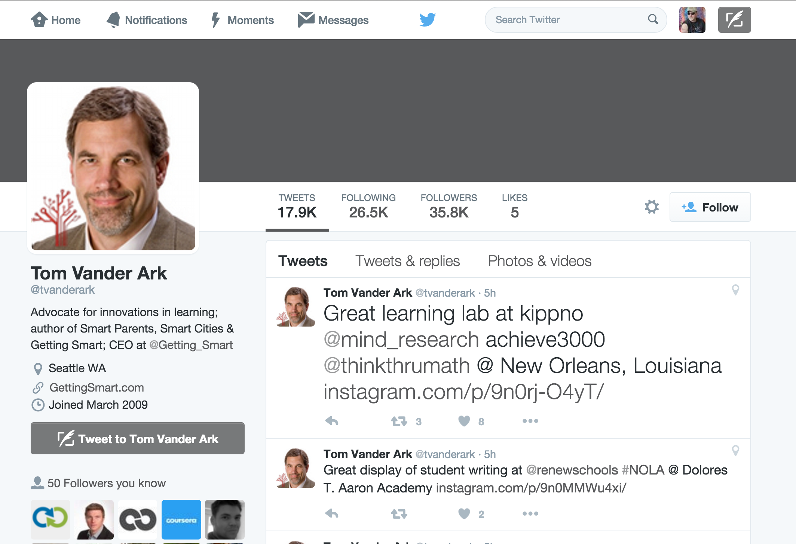
http://gettingsmart.com/2015/02/beyond-lms-next-gen-learning-platforms/

Slide 36
Next Generation Teaching and Learning
The "post-LMS"

Slide 37
Tenets of the NGTL Movement
NGTL LMSs will be small with few features
They will scale from hundreds of students to millions
Content repositories will be plentiful
Will have better powerful authoring tools than LMSs
Most features come from app stores (also plentiful)
It will scale from hundreds to millions
There will be whole new customers and revenue flows
Students
Teachers

Slide 38
LMS/UI
LMS API Provider
APP
APP
LMS/UI
APP
APP
APP
APP/UI
Content
Repository
APP/UI
APP/UI
LMS/UI

Slide 39
Early Exemplars In The Space
Repositories
Blackboard xpLor
Canvas Commons
App Store:
Canvas EduAppCenter
ELMS Network – Drupal + LTI Provider
Tsugi – www.tsugi.org
Small LMS + App Store + Straight to Teacher
Edmodo – App Store not LTI
Schoology – App Store with LTI

Slide 40
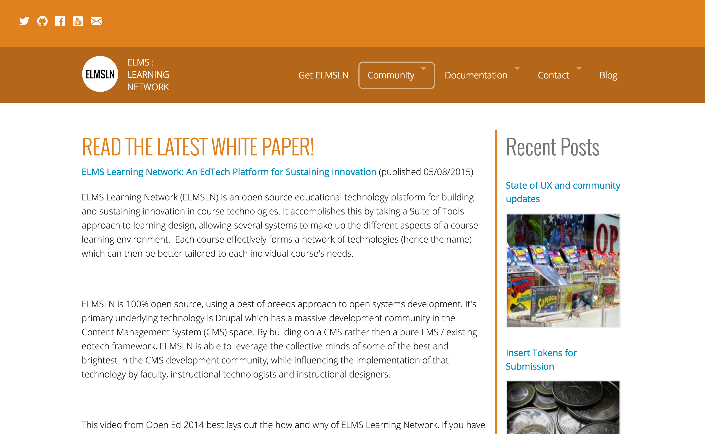
www.elmsln.org

Slide 41
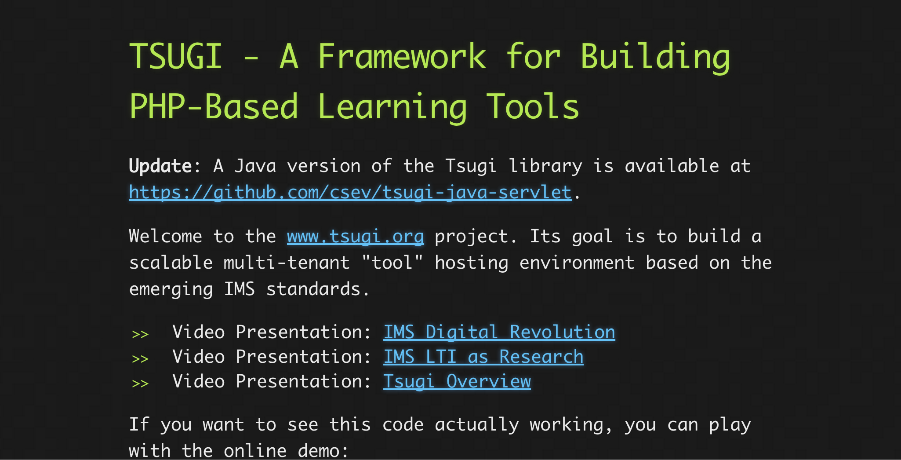
www.tsugi.org

Slide 42
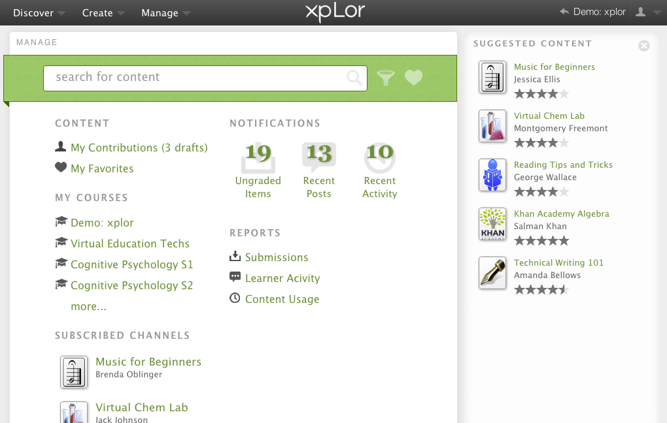

Slide 43
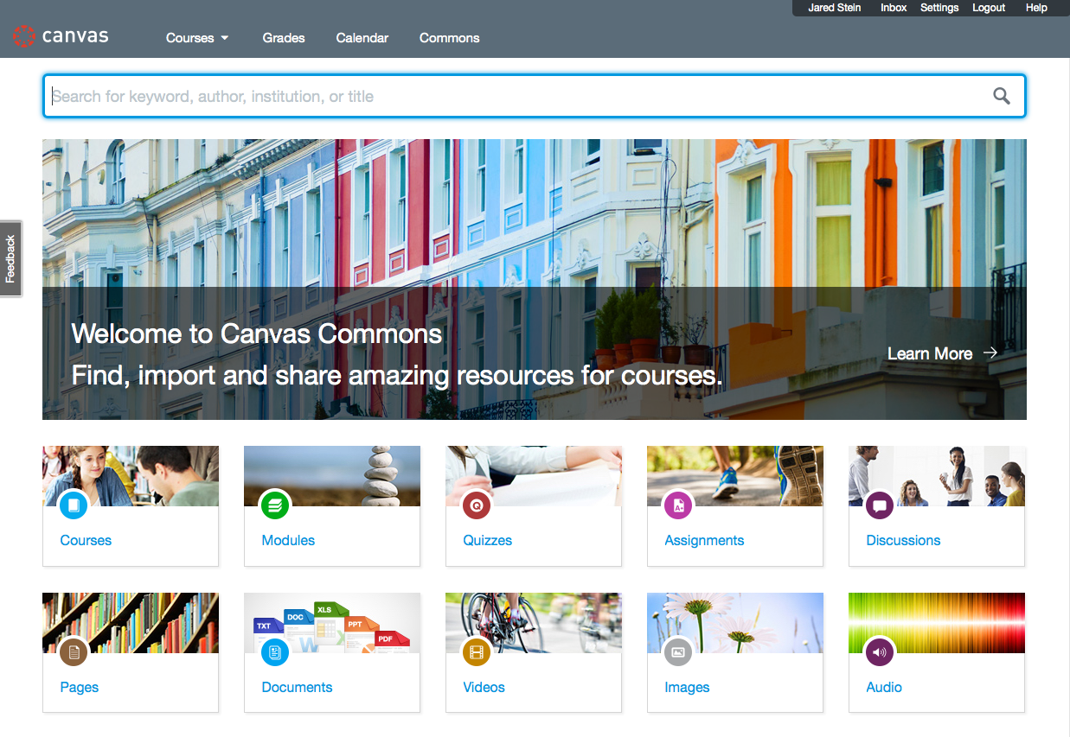

Slide 44


Slide 45
Sakai / OAE Survival Plan
Standards
App Stores
Use them seamlessly
Become an App Store
Content Repositories
Use them seamlessly
Become content a content repository (with editing, versioning, etc)
Don't fall behind, prepare to be inverted

Slide 46
Which LMS will Lead?
LMS | LTI 1.x | Common Cartridge | Content Item | LTI 2.x | Caliper
Canvas | A | A | A | B+
Sakai | A | A | A- | A-
Moodle | A | A | B | B
D2L | A | A
Blackboard | A | A

Slide 47
Open Source must lead the market into Next Generation Teaching and Learning systems
P.S. This needs some investment... And a workshop or two.

Slide 48
